Slide 1
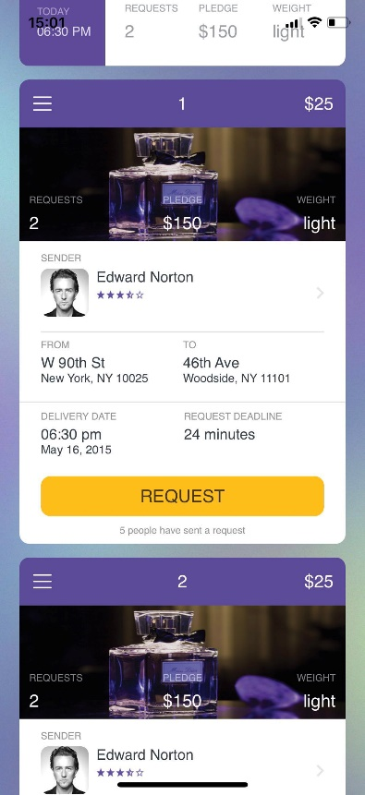
MIND READER
An APP that reads your mind,
better than your boyfriend does.

Slide 2

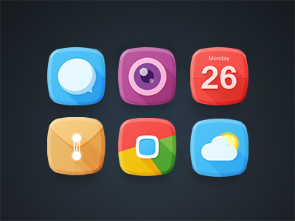
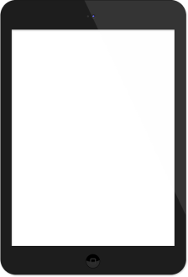
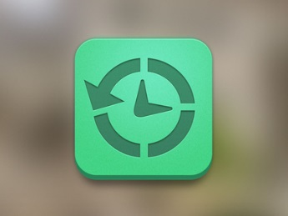
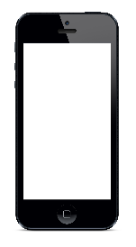
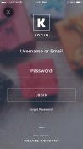
CONTENT
01
INSPIRATION
02
FUNCTIONS
03
TECHNOLOGY
04
APPLICATIONS

Slide 3
INSPIRATION

Slide 4
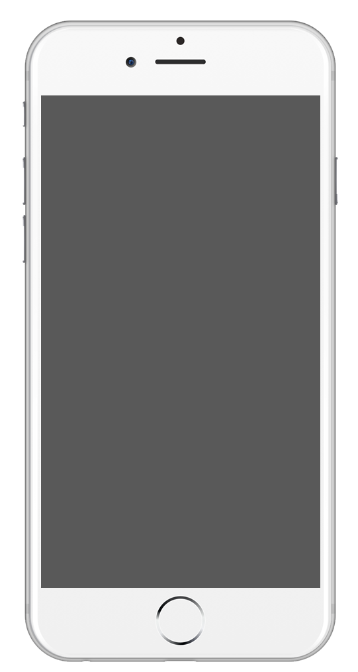
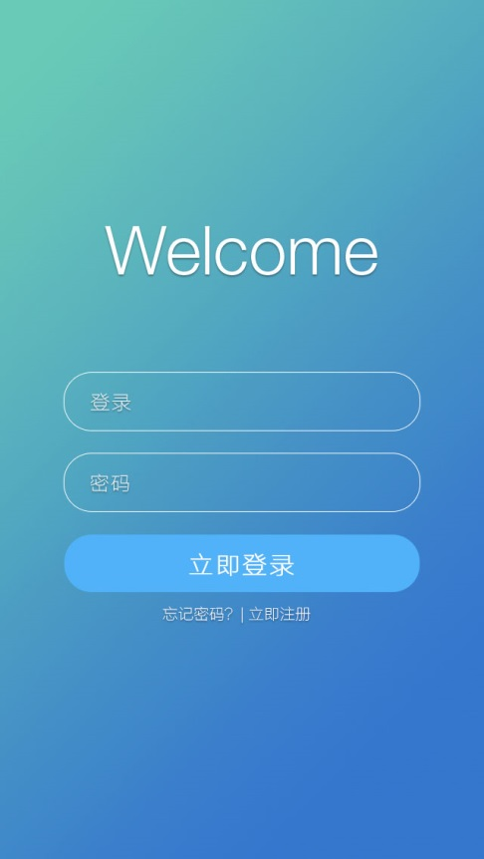




FUNCTIONS - OVERVIEW
Ⅰ. Acquisition
Acquire user data by automatic crawling from social media (Weibo, moments, Twitter, etc. )
Ⅲ. Recommendation
Make recommendations according to data analysis about gifts, movies, music, etc.
Ⅱ. Analysis
Analyze the data through artificial intelligence; form insights into users’ preferences (personality, value, historical comparison, etc. )
Ⅳ. Visualization
Visualize the analysis results and recommendations via charts in the app.

Slide 5
FUNCTIONS - DISPLAY

Slide 6



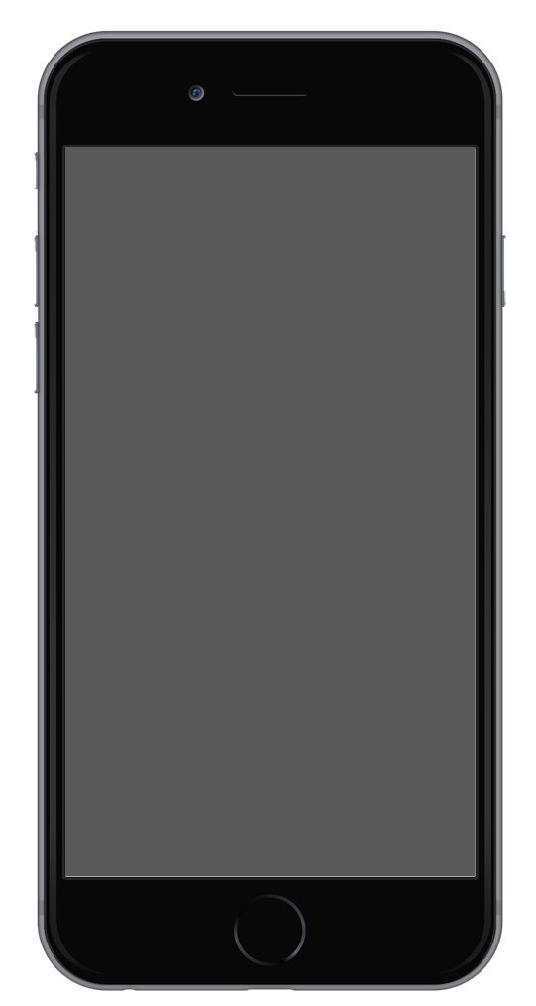
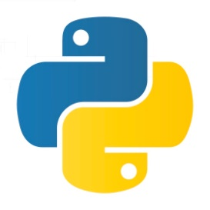


TECHNOLOGY – PLATFORM & LANGUAGES
Personality insights
Natural language understanding
Watson
Language transfer
Open Whisk
Watson
Swift
Python

Slide 7
TECHNOLOGY – FRAMEWORK

Slide 8
APPLICATIONS - SCENARIOS

Slide 9
APPLICATIONS – FUTURE IMPROVEMENT

